Slide 1
Practical Test For CPU Intern
Name: Koki Charity Mulei

Slide 2
Question 1
Language: Python (Django)
Database : Postgres SQL

Slide 3
System Design Process
Patient approaches registration and shares details
Dispensary checks whether patient exist
New patient
Existing Patient
Record new patient details
Retrieve patient details

Slide 4
API functionality
Created an API using Django rest framework.
Django rest framework allows users to create interactive web api’s.

Slide 5
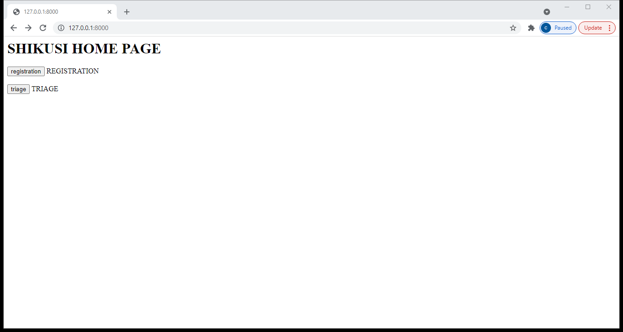
Sample Screenshot Output Shikusi Homepage

Slide 6
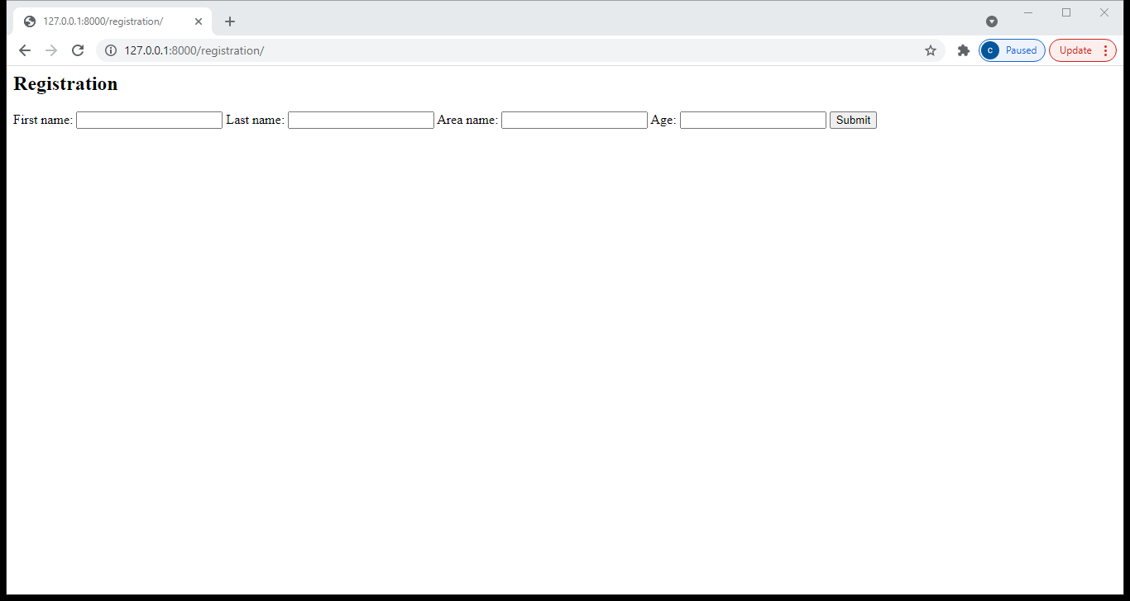
Registration

Slide 7
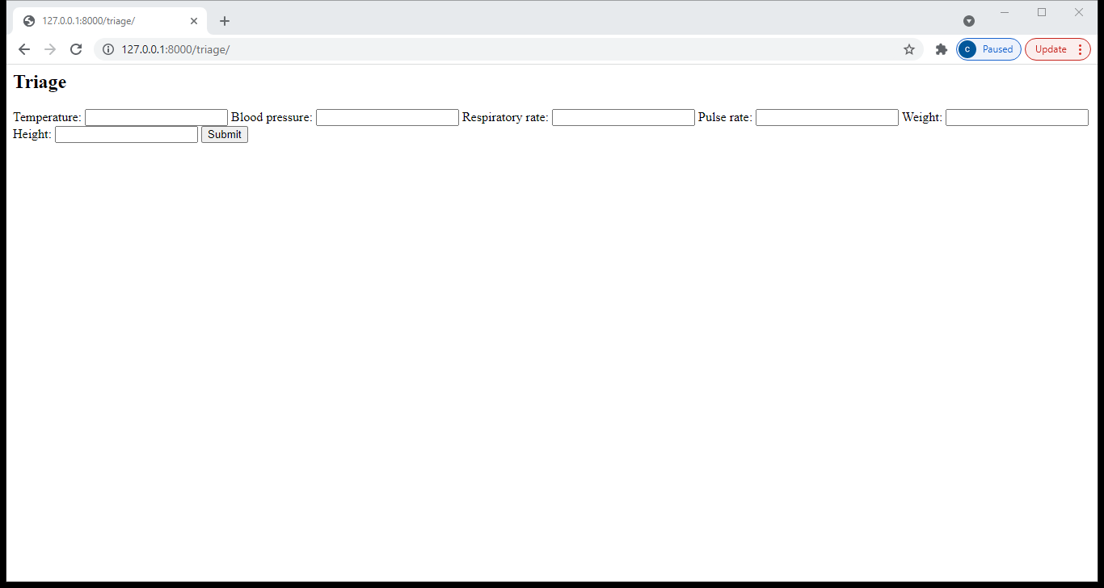
Triage

